Slide 1
Pattern Classification Pattern Classification (2nd ed) by R. O. Duda, P. E. Hart and D. G. Stork, John Wiley & Sons, 2000

Slide 2
Chapter 1: Introduction to Pattern Recognition (Sections 1.1-1.6)
What is Pattern Recognition
Machine Perception
An Example
Pattern Recognition Systems
The Design Cycle
Learning Paradigms
Conclusion

Slide 3

What is Pattern Recognition
A pattern is a form, template, or model
(or, more abstractly, a set of rules)
which can be used to make or to generate things
or parts of a thing,
especially if the things that are generated are common
enough for the underlying pattern to be inferred
or discerned, in which case the things are said to
exhibit the pattern.
The detection of underlying patterns is called pattern recognition

Slide 4
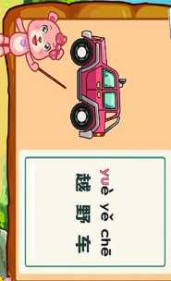

Pattern Examples
Students study
Teachers teach lessons
Pattern: n. + verbal phrase
In layman terms: take in raw data to describe a pattern (sample)and then assign a category or class to the pattern
Cat

Slide 5

A widely used technology
(PR Target) Build a machine that can recognize patterns, for example:
Object recognition
Speech recognition
Fingerprint identification
OCR (Optical Character Recognition)

Slide 6
Pattern recognition technology has been used in almost all of the fields

Slide 7
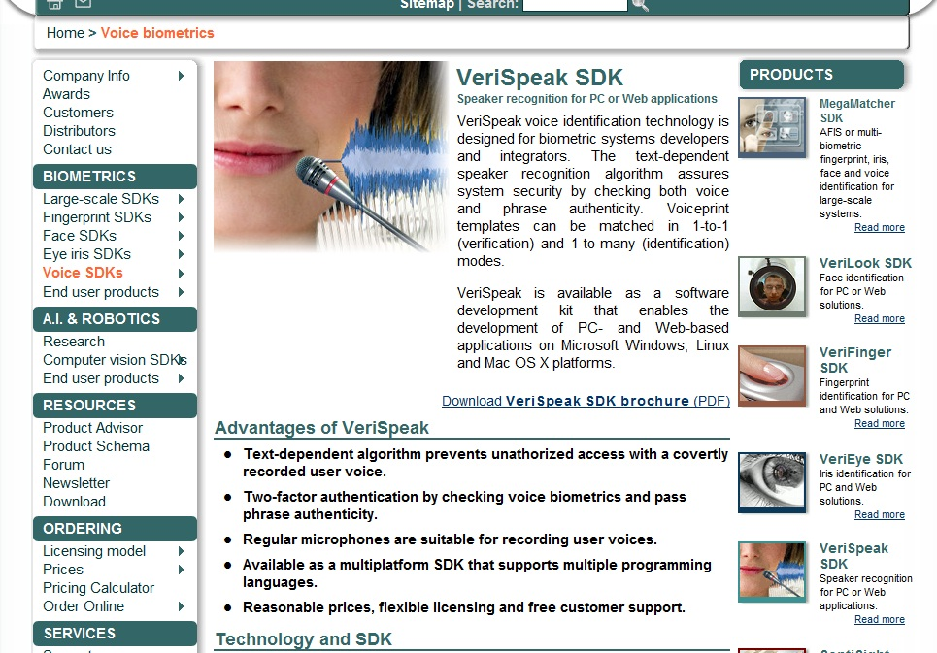

Slide 8
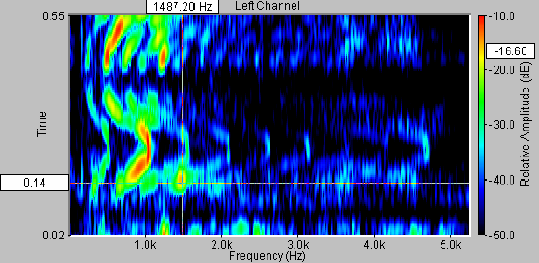
Example: Speech Recognition
Input Raw Data: speech waveform
Output categories: spoken words

Slide 9


Slide 10
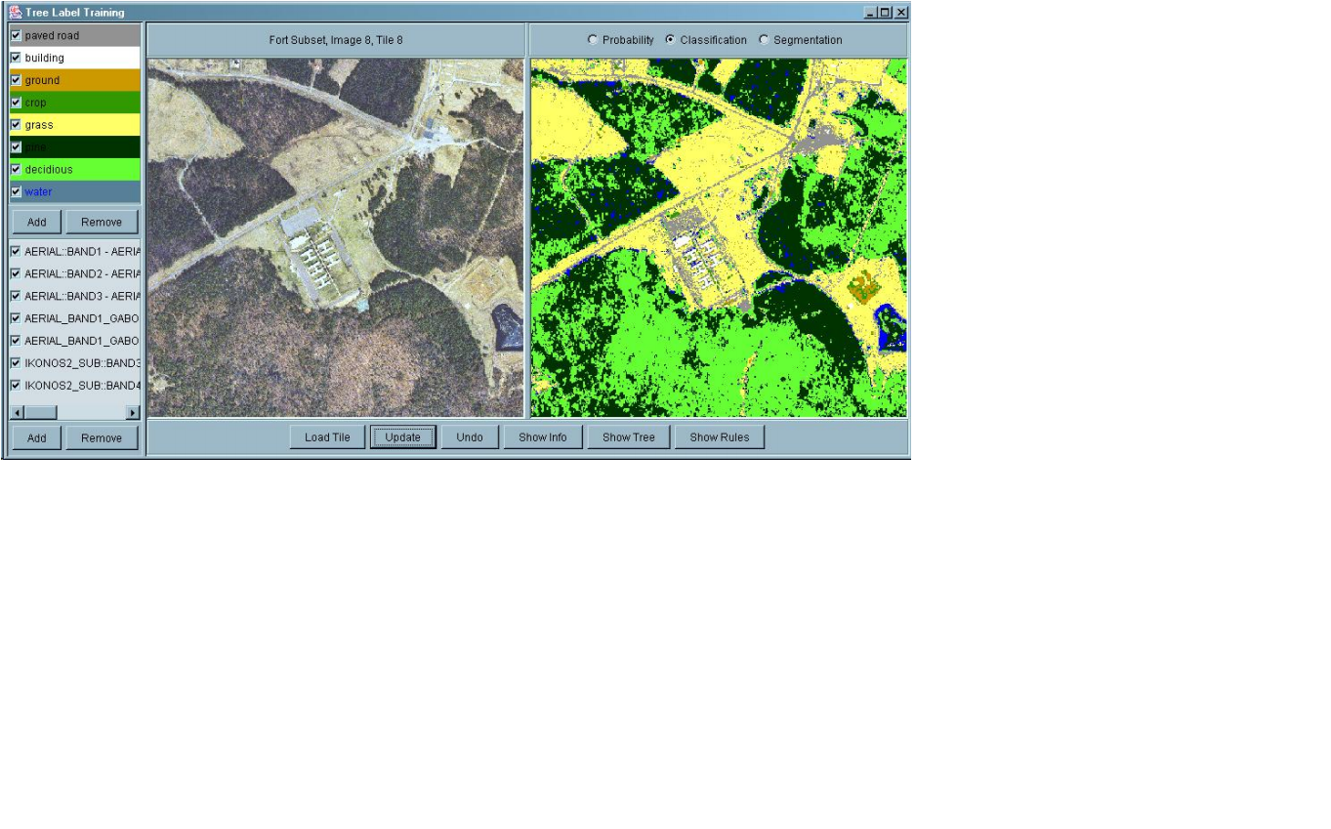

Slide 11



Cloud Patterns

Slide 12




Slide 13
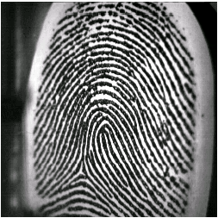
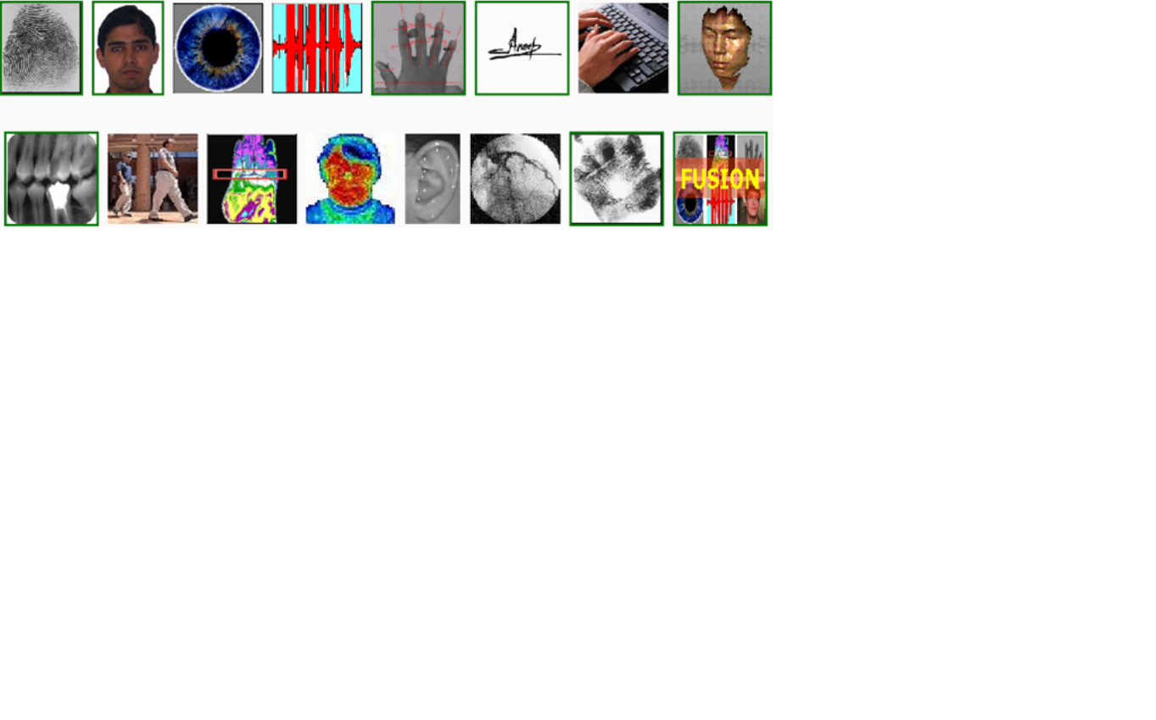

Example: Fingerprint Verification
Input Raw Data: fingerprint image
Output categories: genuine, forged

Slide 14
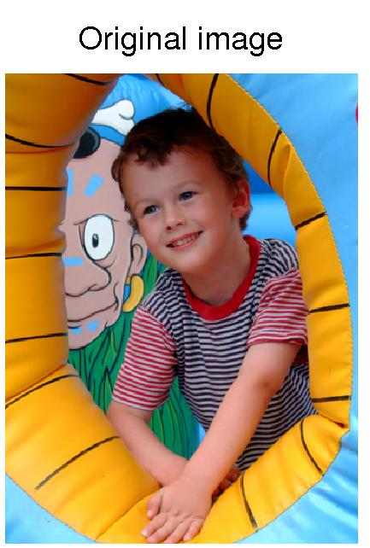
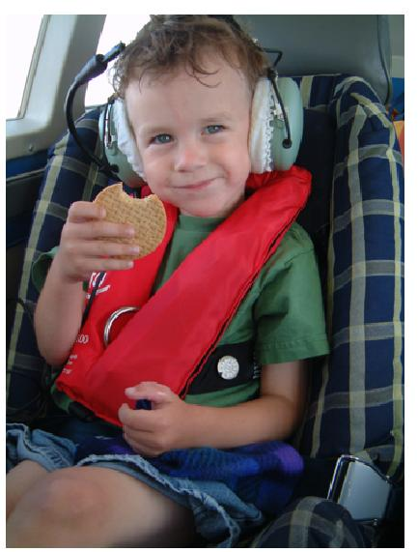
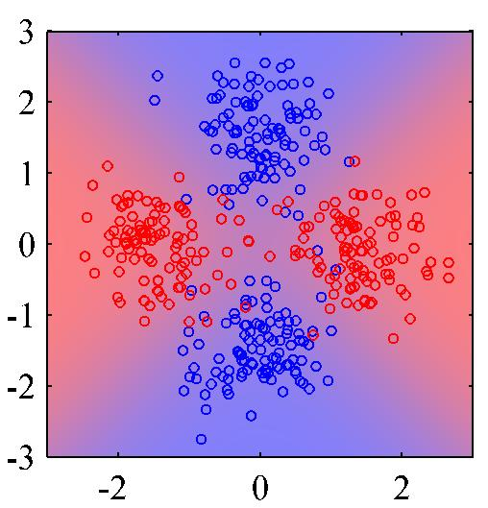
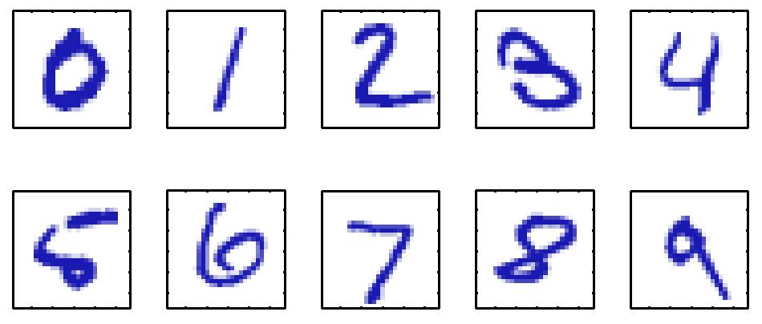




Other examples of patterns

Slide 15
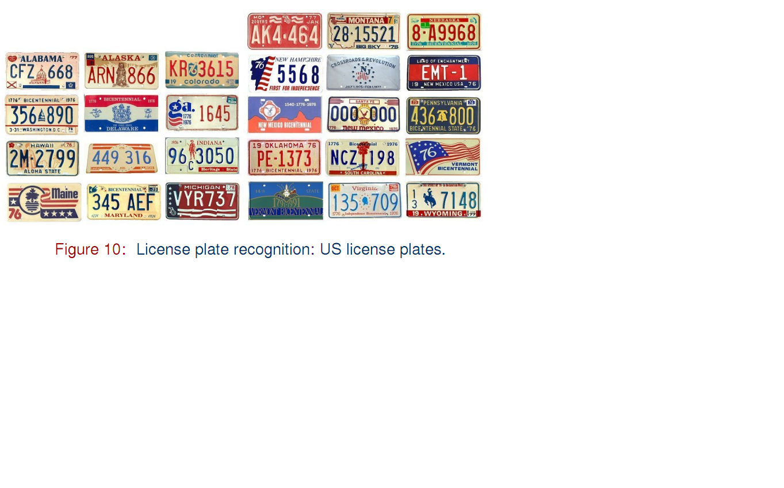

Slide 16
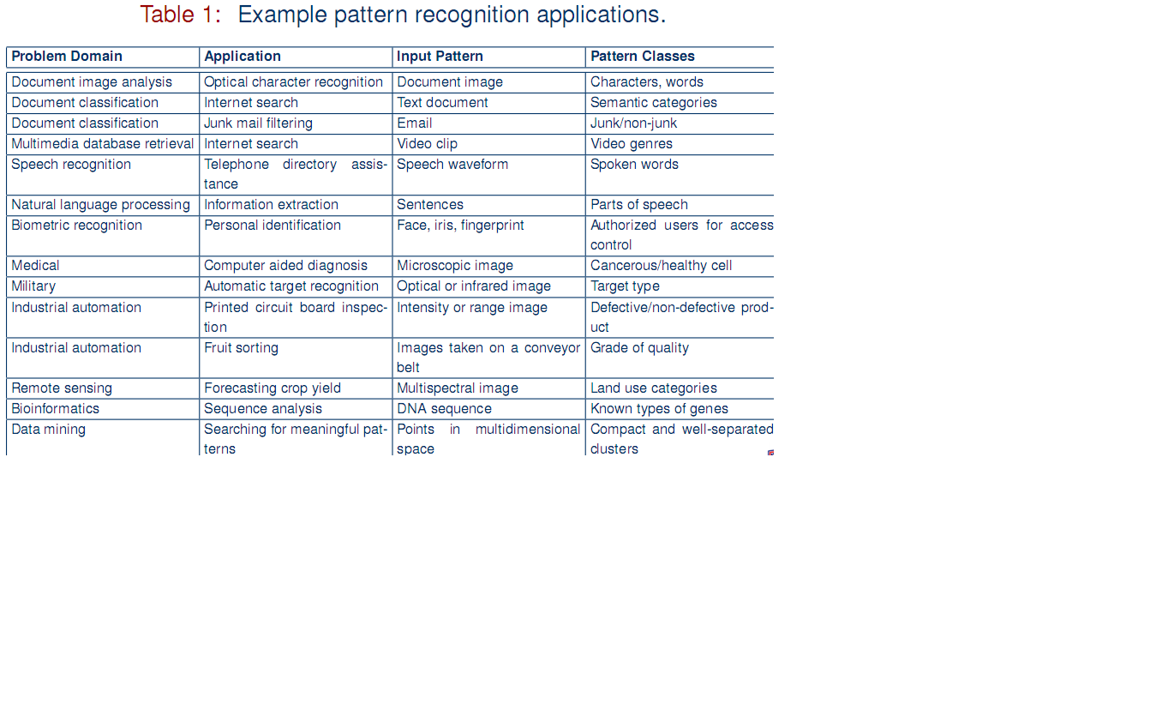

Slide 17
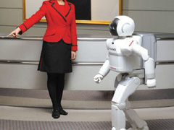
MOTIVATION FOR THE STUDY OF PATTERN RECOGNITION
It is threefold.
It is an essential part of the broader field of Artificial Intelligence, which is concerned with techniques, that enable computers to do things, that seem intelligent when done by people.
It is an important aspect of applying computers to solve problems in science and engineering, since many of them involve analysis and classification of measurements, taken from physical processes.
Pattern Recognition techniques provide a unified frame work to study a variety of techniques, in mathematics and computer science, that are individually useful in many different applications.

Slide 18

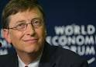
I think it's fair to say that personal computers have become the
most empowering tool we've ever created. They're tools of
communication, they're tools of creativity, and they can be
shaped by their user.---Bill Gates
Bill also said that our final goal would be to make
the computer able to listen, see and speak!!

Slide 19
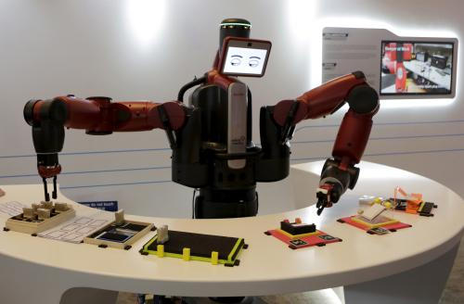
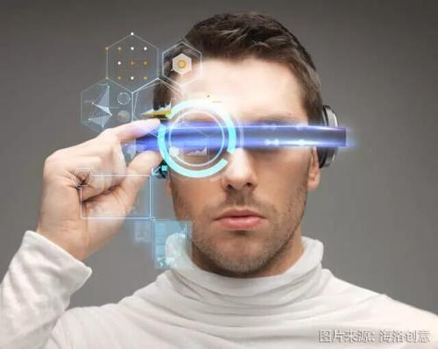


Slide 20
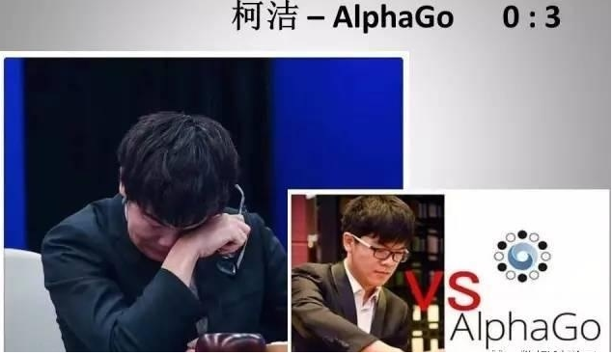
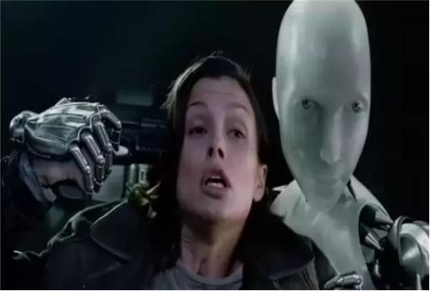
Are humans loser when meeting AI ?

Slide 21
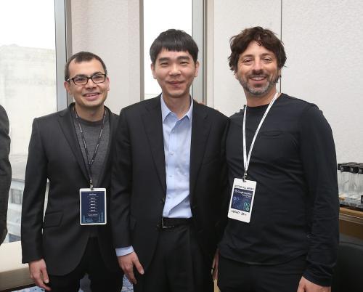
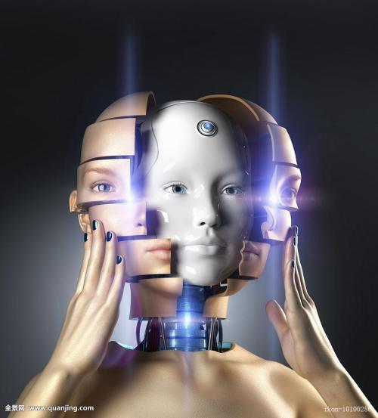
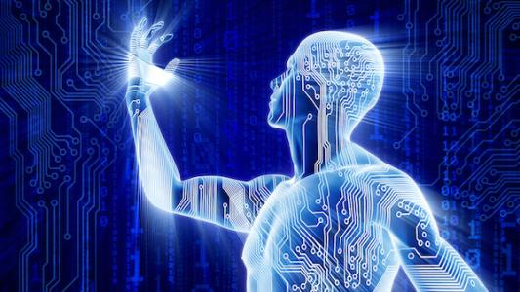
AI depends on humans’ wisdom

Slide 22
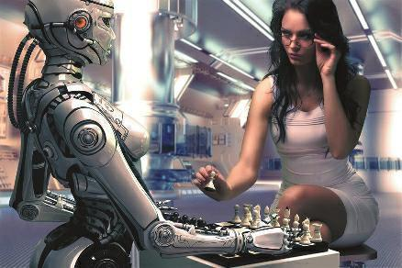
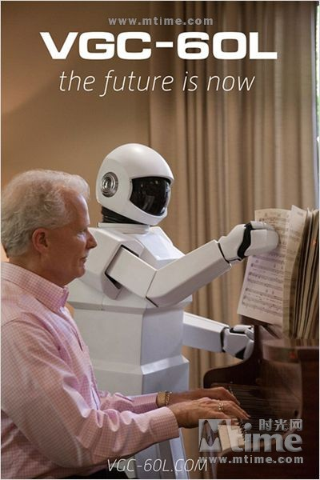
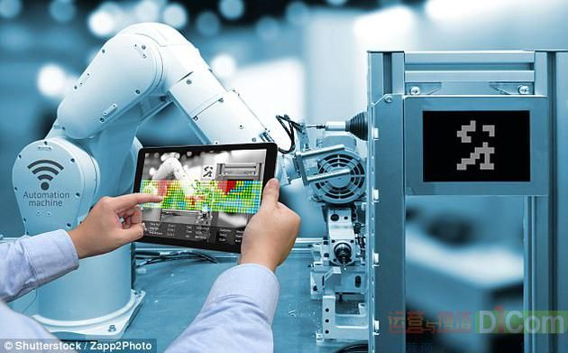

Slide 23

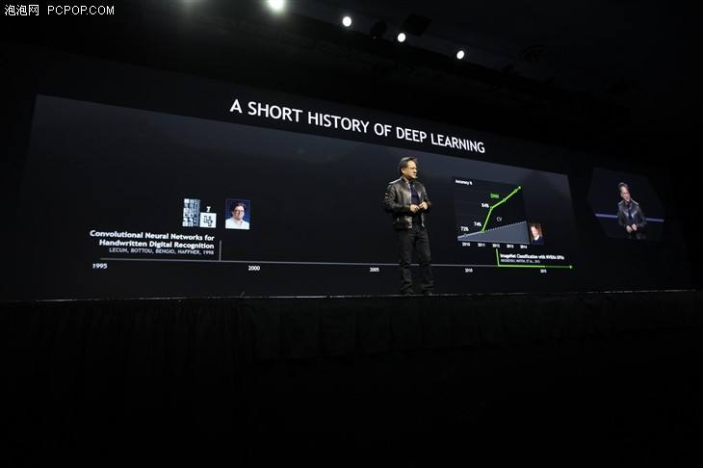
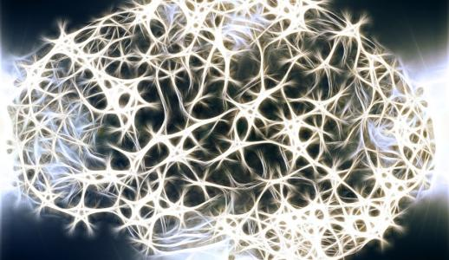
Integration of multiple techniques

Slide 24
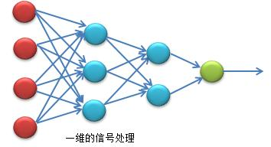
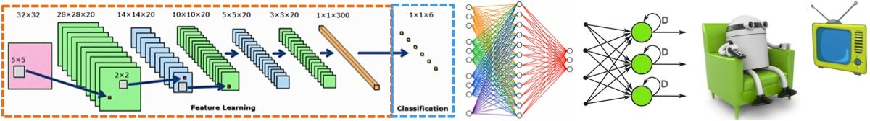
Deep learning

Slide 25
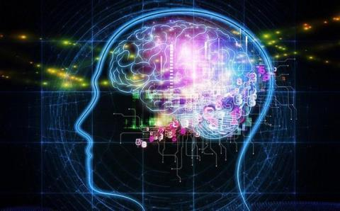
Deep learning

Slide 26
Deep learning: somewhat likes humans’ learning
Humans: Instances (Data) → knowledge
Machine: Massive data→ Knowledge from
Predefined results
End to End

Slide 27
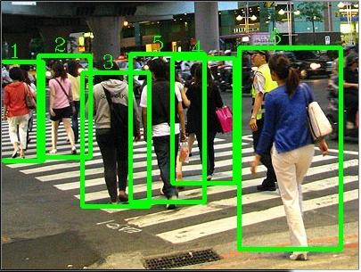
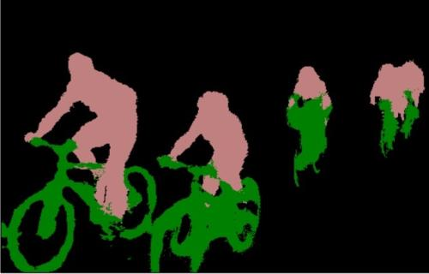
key: Patter recognition

Slide 28
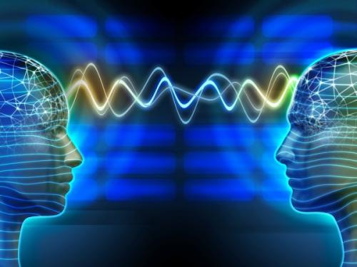
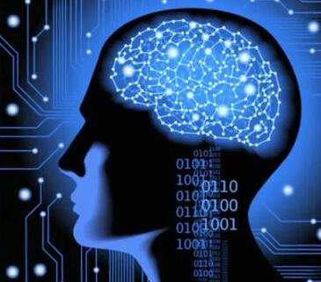
Learning from the brain
The most complex and interesting thing in the world

Slide 29
“Patterns” in the brain
Definitions and representations of patterns
Abstract of objects
“Computations” of the brain: imaginal thinking

Slide 30



Slide 31
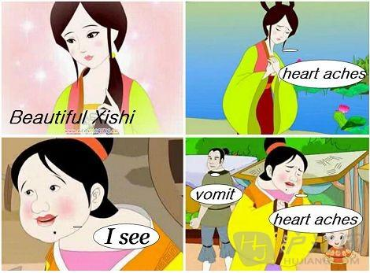
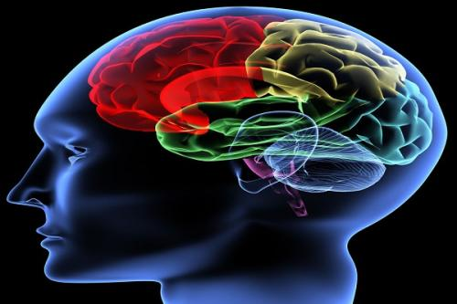
Learning from the brain
Simulation of the structure of the brain
Simulation of the function of the brain

Slide 32

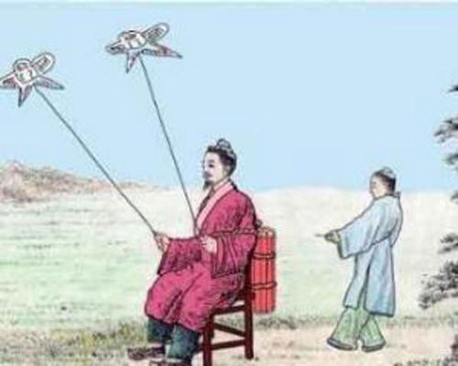
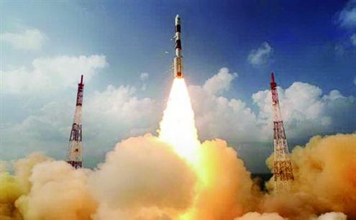
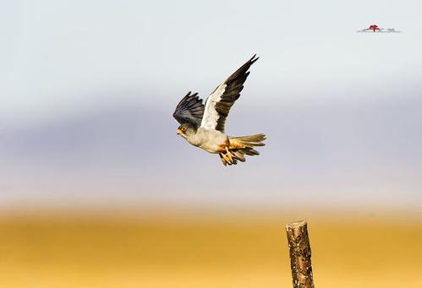
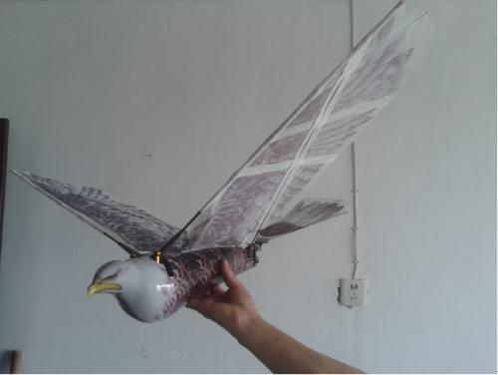
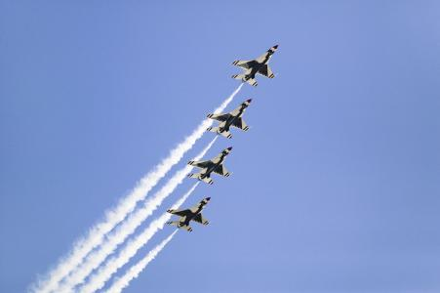
Exploration and advances

Slide 33

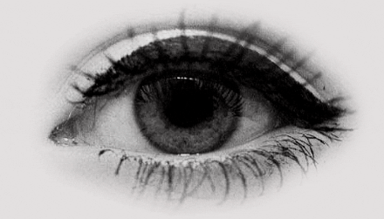

Future: AI and PR
Endless

Slide 34





Basic goal of Pattern classification
Assign a proper label to a new pattern (sample)
Woman
Man
known
unknown
Woman or man ??

Slide 35
How to a system work: simple demo
Face recognition

Slide 36
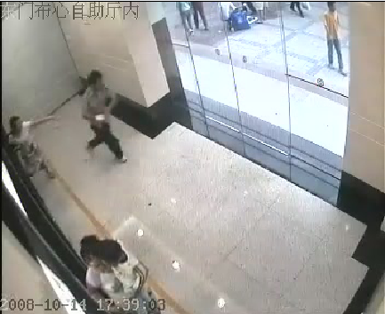
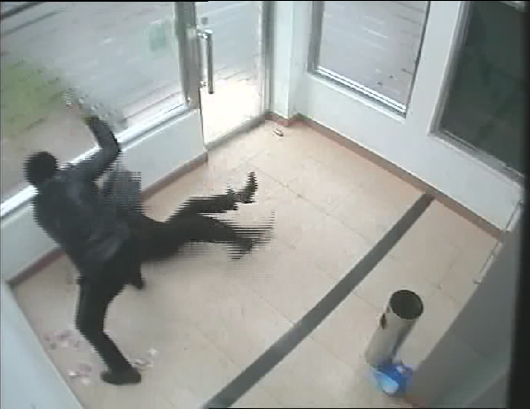


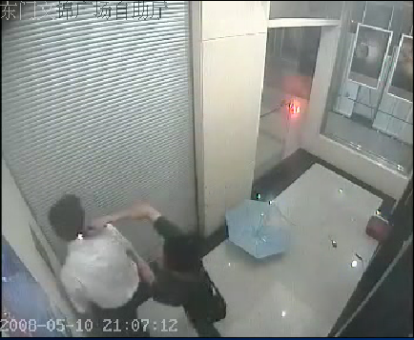
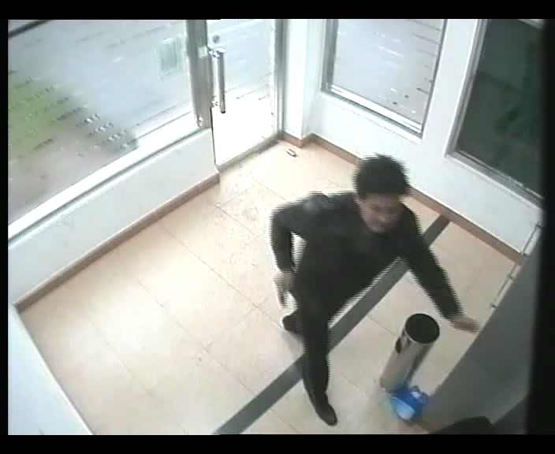
An example
36

Slide 37
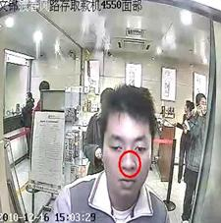
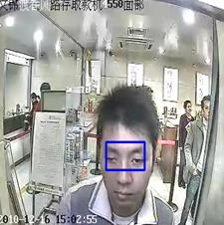
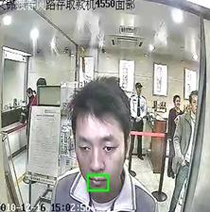
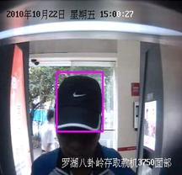
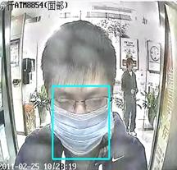

Another example
37

Slide 38




TYPE OF PATTERNS
1.SPATIAL PATTERNS- These patterns are located in space.
Eg:- characters in character recognition
* images of ground covers in remote sensing
* images of medical diagnosis.
2.TEMPORAL PATTERN-These are distributed in time.
Eg:- Radar signal, speech recognition, sonar signal etc.
3.ABSTRACT PATTERNS-Here the patterns are distributed neither in space nor time.
Eg:- classification of people based on psychological tests.
* Medical diagnosis based on medical history and other
medical tests.
* Classification of people based on language they speak.

Slide 39


APPROACH TO PATTERN RECOGNITION
1.Statistical or decision theoretic or discriminant method.
2.Syntactic or Grammatical or structural approach.

Slide 40


STATISTICAL APPROACH: Using statistics to determine the relationship between inputs and outputs
Fig1.1: Block diagram representation of statistical approach
Transducer : It is used for making measurements for various attributes of the pattern.
Feature Extractor: From the measurements, it extracts, number of features which are
required for describing the pattern and classifying.
Patterns
Results
Transducer
Feature Extraction
And
Feature Selection
Learning
Classification

Slide 41

MACHINE PERCEPTION
It is natural that we should seek to design and build machines that can recognize patterns. From automated speech recognition, fingerprint identification, optical character recognition, DNA sequence identification, and much more, it is clear that reliable, accurate pattern recognition by machine would be immensely useful. Moreover, in solving the myriad problems required to build such systems, we gain deeper understanding and appreciation for pattern recognition systems in the natural world- most particularly in humans. For some problems, such as speech and visual recognition, our design efforts may in fact be influenced by knowledge of how these are solved in nature, both in the algorithms we employ and in the design of special-purpose hardware.

Slide 42
STATISTICAL APPROACH
There are two feature selector methods.
1.Transformation Method :
Here we reduce the features by considering the linear or nonlinear combinations of original features. This is also called as aggregation method.
Eg:- let us assume originally we have four features f1,f2,f3,f4.
One method of selecting two features is
f5 = f1 + f2
f6 = f3 + f4.
2.Subsetting or filtering Method:
Here we select a subset of the original features.
Eg:- Original features are f1,f2,f3,f4.
We can select a subset like
f5 = f1 and f6 = f3.
Learning : It is a process of determining useful parameters which are required for classifying the patterns efficiently.
Classifying: Here the patterns are assigned to different classes using a suitable classification method as shown in the fig 1.1

Slide 43
Classification Method
Ground
Cover
Results
Multispectral
Scanner
In Satellite
4 dimensional
data
2 dimensional
data
Learn m and c in
y=mx+c
Classify
Fig : A Classification Method

Slide 44


SYNTACTIC APPROACH
Here we use the analogy between the structures of a pattern and the structure
of sentence, written using a grammar.
E.g.: Rama was a very good king.
Here we decompose the pattern into sub-patterns called primitives when primitives are combined together using a certain syntax rule, we get the original pattern. So this method consists of parsing the pattern using a syntax rule.
Advantages : It classifies the pattern.
It describes the pattern.

Slide 45


SYNTACTIC APPROACH

Slide 46

Example: Character Recognition
Input Raw Data: image
Output categories: characters

Slide 47





Difficulties
Similar patterns of different classes
Noise
Outlier
How to correctly distinguish
the blue sky from blue water?!
Zhou Bichang ？
The men more beautiful than women!: Italian

Slide 48





Difficulties
Similar characteristics etc.
Deformable patterns
轻松一刻：某男拿着医生开的处方在医院里转了半天，回来问：“13超到底在哪?”
女医生笑曰：“那不是13超，是B超。”
Story: this is
not a person !

Slide 49
An Example With More Details
Sorting incoming Fish on a conveyor belt according to species using optical sensing
Sea bass
Species
Salmon

Slide 50
Sensing
Set up a camera and take some sample images to extract features
Length
Lightness
Width
Number and shape of fins
Position of the mouth, etc…
This is the set of all suggested features to explore for use in our classifier!

Slide 51

Other application
Preprocessing
Use a segmentation operation to isolate fishes from one another and from the background
Information from a single fish is sent to a feature extractor whose purpose is to reduce the data by measuring certain features
The features are passed to a classifier

Slide 52

Gray images are used:
the pixel value is in the range of 0-255
A large pixel value means that the pixel is bright in vision

Slide 53


Black Swan
How to select the feature?
Black Swan
Classification
Select the length of the fish as a possible feature for discrimination

Slide 54


Slide 55
The length is a poor feature alone!
Select the lightness as a possible feature.

Slide 56


Slide 57
Threshold decision boundary and cost relationship
Move our decision boundary toward smaller values of lightness in order to minimize the cost (reduce the number of sea bass that are classified salmon!)
Task of decision theory

Slide 58
Adopt the lightness and add the width of the fish
Fish x^{T} = [x₁, x₂]
Lightness
Width

Slide 59


Slide 60
We might add other features that are not correlated with the ones we already have. A precaution should be taken not to reduce the performance by adding such “noisy features”
Ideally, the best decision boundary should be the one which provides an optimal performance such as in the following figure:

Slide 61

The decision boundary with high complexity means that unseen samples (patterns)
cannot be recognized very well (poor generalization).
某企业引进一条香皂包装生产线，结果发现经常有空盒流过。
厂长请一个博士后花了200万设计出了自动分检系统。一乡镇
企业遇到同样问题，农民工花90元买一大电扇放在生产线旁，
有空盒经过便被吹走。

Slide 62



However, our satisfaction is premature because the central aim of designing a classifier is to correctly classify novel inputs Issue of poor generalization!!
If the algorithm just “remembers” that the rose is only red or pink
then it cannot correctly recognize the following blue rose as a rose

Slide 63

Tradeoff between the complexity of the decision boundary and classification correct rate

Slide 64



Slide 65








Slide 66

Examples of classifiers

Slide 67

Theory: Classifiers with proper low complexity is favored

Slide 68

More training samples are better

Slide 69
Success of deep learning
Deep network(complex algorithm)
+
Big data (massive samples)

Slide 70
Note:
A classifier model not only should learn to classify the training samples, but it should also be able to generalize its classification ability to unseen test samples.
Generalization error rate
Classification error rate of a trained classifier tested on a sufficiently large set of test samples.

Slide 71



Slide 72


Generalized ability
Low error rate on training samples
Low error rate on training samples
Low error rate on test samples
Relatively high error rate on test samples
Generalize well
Generalize badly

Slide 73



Computational Complexity
trade off between computational ease and performance
Complexity of learning (done in lab) and the complexity of making decision (done with the fielded application)

Slide 74
Pattern Recognition Systems
Sensing
Use of a transducer (camera or microphone)
PR system depends of the bandwidth, resolution ,sensitivity, distortion of the transducer
Segmentation and grouping
Patterns should be well separated and should not overlap
Grouping together the various parts of a composite object

Slide 75

Flowchart of a pattern recognition system: Training and test

Slide 76
Training
The process of using data to determine the classifier. Many different procedures have been proposed for training classifiers and choosing models
We are mainly interested in trainable or learnable pattern recognition systems in which the classifiers learn to perform classification from training

Slide 77


Slide 78
Feature extraction
Discriminative features
Invariant features with respect to translation, rotation and scale.
Classification
Use a feature vector provided by a feature extractor to assign the object to a category
Two factors decide the degree of difficulty of classification
Variability in the feature values in the same category (cpl, ns)
Variability in the feature values in the different categories
Post Processing
Exploit context input-dependent information other than from the target pattern itself to improve performance
Use the output of the classifier to decide on the recommended action (cost)

Slide 79
The Design Cycle
Data collection
Feature Choice
Model Choice
Training
Evaluation
Computational Complexity

Slide 80


Data Collection
How do we know when we have collected an adequately large and representative set of examples for training and testing the system?

Slide 81
Feature Choice
Depends on the characteristics of the problem domain. Simple to extract, invariant to irrelevant transformation insensitive to noise.
A feature vector is a vector of features usually expressed as a column vector:

Slide 82
Example of bad feature: position of fish on conveyor belt.
A feature space is a space of all possible feature vectors that can be represented under some feature representation scheme
Example of a 3-dimensional feature space:

Slide 83


Feature transform

Slide 84
Model Choice
Unsatisfied with the performance of our fish classifier and want to jump to another class of model
(Problem) How do we know to reject a class of models and try another one

Slide 85
More exploration
How to make the machine work better in pattern recognition ?
Can the pattern recognition ability of the machine be greater than the human?
What can we do now?

Slide 86
Learning Paradigms
Learning
Supervised learning
A teacher provides a category label or cost for each pattern in the training set
Training examples as input-output pattern pairs, with labeled output provided by a teacher.

Slide 87
SL System
Teacher
x
y
d
G (x)
F (x)
x
Examples:
Teaching children to recognize different animals.
Graded examinations with correct answers provided.

Slide 88
UL System
x
y
F (x)
Unsupervised learning
Training examples as input patterns only with no associated output patterns (i.e., no teacher)
Clustering is a form of unsupervised learning (based on some similarity
Examples:
Grouping animals into different classes according to their similarity.

Slide 89



How to make the machine work better in pattern recognition ?
Intelligent feedback learning
Interaction
Intelligent: somewhat human-like ability

Slide 90




Can the pattern recognition ability of the machine be greater than the human?
In some aspects the answer is yes.
In many aspects the answer is no.
It’s terrible for the machine is more smart than the human from the viewpoint of morality.

Slide 91


What can we do now?
imagery thinking ? logical thinking ?
For prompting the pattern recognition technology, we had better
focus on what it is good at
Data processing
Determinative decision making
Limited interaction learning
Robust
not waste the time on what it is incompetent.
Imagery thinking

Slide 92






What’s the extreme potential of the pattern recognition technology?
Will the time when the intelligent machine govern the earth and people come ?
Where is the farthest place?

